Slide 1
April 27, 2025
Notes:
Check the lyrics and service order with the bulletin

Slide 2
Caring for Creation
Notes:
Check the lyrics and service order with the bulletin

Slide 3
HE IS RISEN!
Northfield United Methodist Church
1411 Maple St.
Northfield, MN 55057
Northfieldumc.org
Worship. Compassion. Devotion. Justice.

Slide 4
Greeting and Welcome

Slide 5
Passing of the Peace

Slide 6
O give thanks to our God who is good; whose love endures forever. Sunrise and sunset, night and day: give to our God your thanks and praise. mountains and valleys, big woods and groundwater aquifers, wetlands and prairies: give to our God your thanks and praise. Rivers and straits, bogs and fens, Great

Slide 7
Lakes and Boundary Waters: give to our God your thanks and praise. Maples and firs, birch and cedars, mosses and ferns: give to our God your thanks and praise. Northern pike and brownie trout, deer and fox, soaring bald eagles and cheering robins: give to our God your thanks and praise.

Slide 8
Immigrants and natives, women and men, people who inhabit the Heartland: give to our God your thanks and praise. Saints and martyrs and living creatures of the biomes we call the Midwest: give to our God your thanks and praise. Amen.

Slide 9
God of the Sparrow, God of the Whale UMH #122 vs 1-4

Slide 10
God of the sparrow God of the whale God of the swirling stars How does the creature say Awe How does the creature say Praise God of the earthquake God of the storm God of the trumpet blast How does the creature say Woe How does the creature cry Save

Slide 11
God of the rainbow God of the cross God of the empty grave How does the creature say Grace How does the creature say Thanks God of the hungry God of the sick God of the prodigal How does the creature say Care How does the creature cry Life

Slide 12
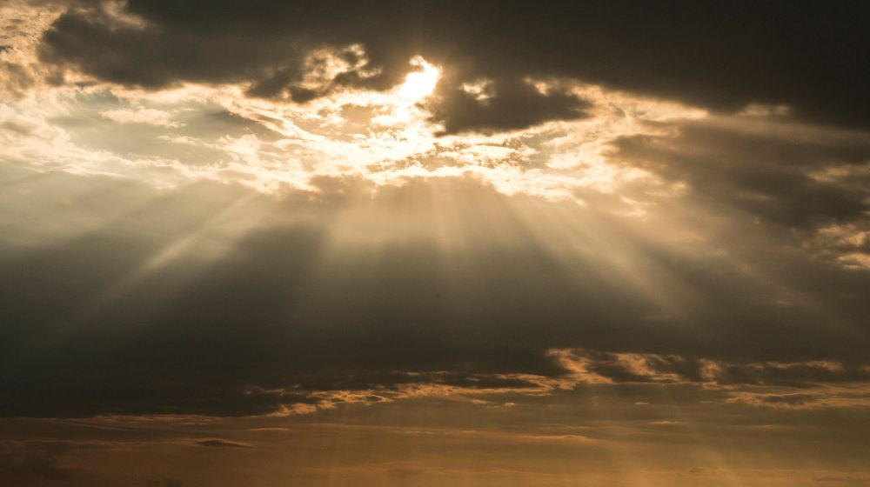
Prayer | Lord’s Prayer

Slide 13
We thank you that you have called us to celebrate your creation. Give us reverence for life in your world. We thank you for your redeeming love; may your word and sacrament strengthen us to love as you love us.

Slide 14
Our Father, who art in heaven, hallowed be thy name. Thy kingdom come, thy will be done, on earth as it is in heaven. Give us this day, our daily bread. And forgive us our trespasses, as we forgive those who trespass against us. And lead us not into temptation, but deliver us from evil. For thine is the kingdom and the power and the glory forever. Amen.

Slide 15
John 20:1-18

Slide 16
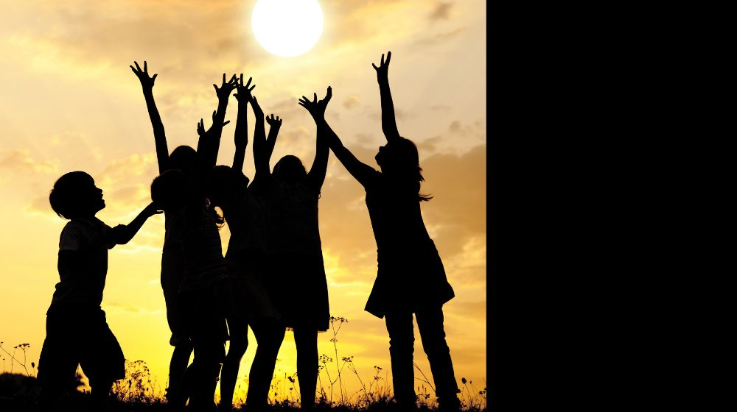
Children’s Message

Slide 17
In the Garden UMH #314

Slide 18
I come to the garden alone While the dew is still on the roses, And the voice I hear falling on my ear, The Son of God discloses. And he walks with me, and he talks with me, And he tells me I am his own; And the joy we share as we tarry there, None other has ever known.

Slide 19
He speaks, and the sound of his voice Is so sweet the birds hush their singing, And the melody that he gave to me Within my heart is ringing. And he walks with me, and he talks with me, And he tells me I am his own; And the joy we share as we tarry there, None other has ever known.

Slide 20
I'd stay in the garden with him Though the night around me be falling, But he bids me go; thru the voice of woe His voice to me is calling. And he walks with me, and he talks with me, And he tells me I am his own; And the joy we share as we tarry there, None other has ever known.

Slide 21
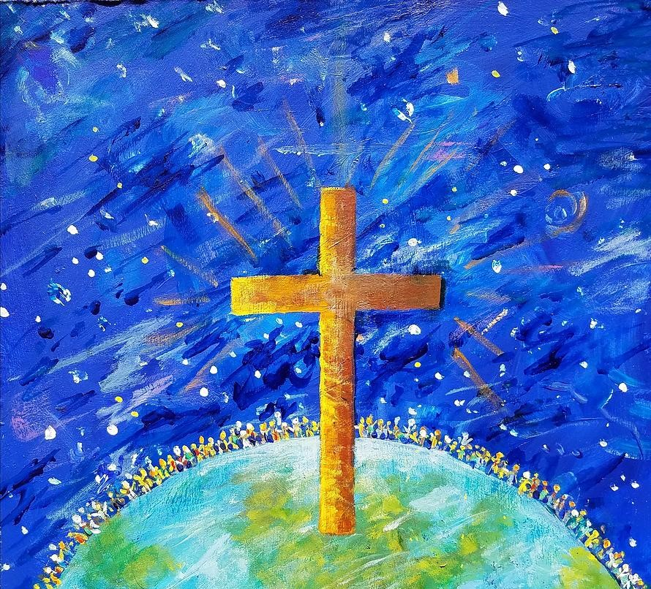
Message

Slide 22
Sharing and Offering
We are able to offer our gifts in-person, electronically, by mail (send to: 1401 Maple Street, Northfield, MN 55057), or online: northfieldumc.org.
Through prayers, presence, gifts, service, and witness, we offer ourselves to God’s work!

Slide 23
A Little Hope in Time Tim Goodwin

Slide 24
God of resurrection and renewal, as spring awakens the earth and Easter fills us with hope, we offer these gifts in gratitude. Use them to heal creation and bring new life to your world. Amen.

Slide 25
Easter People, Raise Your Voices UMH #304

Slide 26
Easter people, raise your voices, Sounds of heaven in earth should ring. Christ has brought us heaven’s choices; Heavenly music, let it ring. Alleluia! Alleluia! Easter people, let us sing. Fear of death can no more stop us From our pressing here below. For our Lord empowered us To triumph over every foe. Alleluia! Alleluia! On to victory now we go.

Slide 27
Every day to us is Easter, With its resurrection song. When in trouble move the faster To our God who rights the wrong. Alleluia! Alleluia! See the power of heavenly throngs.

Slide 28
Benediction

Slide 29
Go now with the risen Christ, who brings life from death, hope from tears. May you walk gently, love boldly, and care deeply for creation and one another. Amen.

Slide 30
INVITATION TO REFLECT

Slide 31
EXPERIENCE: Remember a time of intimate connection with the beauty or power of Creation.
KNOWLEDGE: What do we know about the earth and our role in caring for creation as God cares for us? EMOTION: What emotions come to us

Slide 32
as we consider the way we have lived in the beauty and goodness of the created Earth?
RESPONSE: What have you heard today, or learned at other times, that gives you guidance from our Faith on how one should live as a Christian caring for creation in these times?

Slide 33
HE IS RISEN!
Northfield United Methodist Church
1411 Maple St.
Northfield, MN 55057
Northfieldumc.org
Worship. Compassion. Devotion. Justice.

